Slide 1



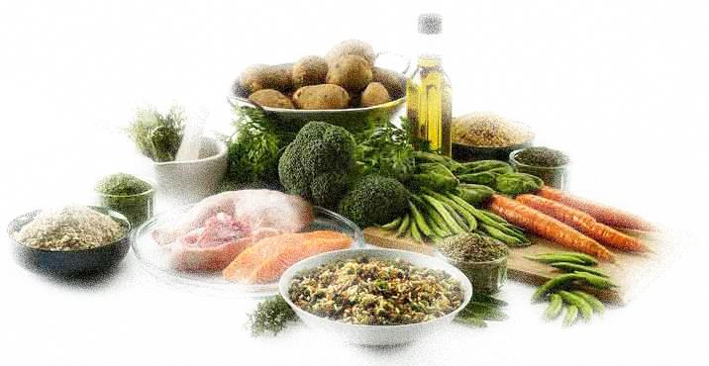
GREENFOODS’ Introduction
To lead the European food and drinks industry to high energy efficiency and reduction of CO₂ emissions;
Utilises the expertise of the 14 partners from Germany, United Kingdom, Spain, Poland and Austria;
To foster global competitiveness, improve the security of energy supply and guarantee the sustainable production;
13 sub-sectors covered in total but with heavier focus on: (i) meat, (ii) fish, (iii) fruits & vegetables, (iv) dairy, (v) bakery, and (vi)beverage;
Covering (i) energy audits, (ii) financial schemes, (iii) branch concept, (iv) training module, and (v) Virtual Energy Competence Centre (VECC).

Slide 2
Summary results from audits
204 basic audits were gathered involving six partners: Austria (54), Spain (47), Poland (39), Germany (28), UK (26), and France (10);
Emission savings: Bakeries-19%, Beverages-11%, Dairy-11%, Fruit/Vegetable-18%, Meat-15%, and all other by 11%;
Implementation of energy efficiency and renewable energy technologies can save 145,000 t CO2e annually; equivalent to removing more than 30,000 cars from the road, installing 44 large wind turbines, or saving ~350,000 barrels of oil.
Full report: http://www.green-foods.eu/results-from-basic-and-detailed-audits-carried-on-the-greenfoods-project/

Slide 3
Problems encountered during audits
Energy auditors do not have sufficient knowledge on processes and products;
A manager in a Scottish whiskey highlighted that a week of his and his staff’s time was wasted on auditors who merely suggest energy efficient measures such as more insulation, turn of lights, switch to LED. He emphasised that the processes are the ones consuming largest amount of energy.
Data not easily accessible available and/or accessible:
  Approval from senior management.
  Cross-departmental liaisons, e.g. sales volume and utility bills.
  Mostly having to deal with production managers who have little knowledge about energy requirement in processes.

Slide 4
Summary of financing instruments
Separate questionnaires for companies & experts for feedbacks;
Tax incentives (rarely available), grants, soft loans and aid for energy audits/consultancy are the most important tools in most countries (with the exception of energy audit in the UK);
The support for energy consultancy/audits was more easily available than support for investments.
Can be complicated, for example Green Deal: to ensure that there is no conflict of interest, there are up to four players each business has to deal with: (i) the assessor, (ii) the advisor, (iii) the provider, and (iv) the installer.
Full report can be downloaded here: http://www.green-foods.eu/funding-and-financing-schemes/

Slide 5
Introduction to Branch Concept
Guides the user to identify tailor-made solutions for “green production”;
Combines (a) process expertise of F&D production, and (b) energy efficiency and renewable expertise;
Output will be in the form of in the form of a energy and material calculation tool to provide profitability assessment and suitable production technology recommendation.
Comparison to the current energy status and show potentials for improvements
Supported by guidelines for implementation

Slide 6
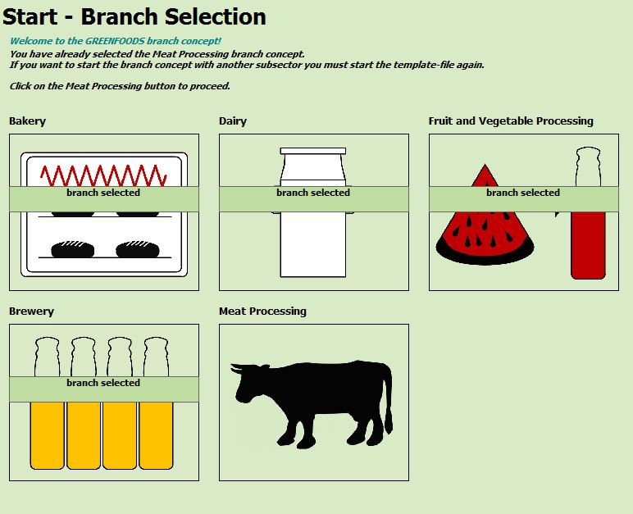
Branch Concept (1)

Slide 7
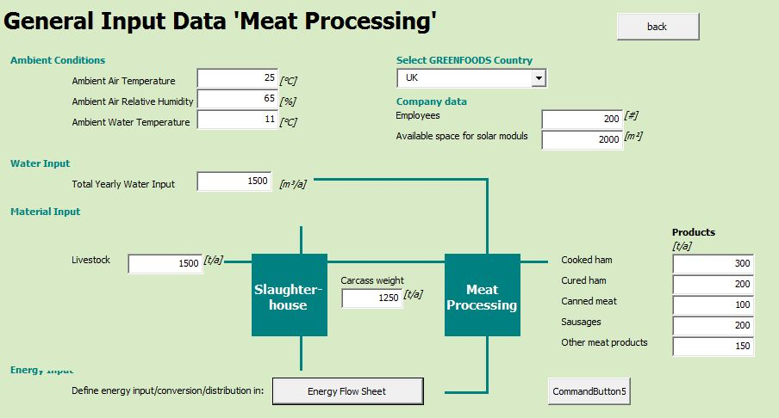
Branch Concept (2)

Slide 8
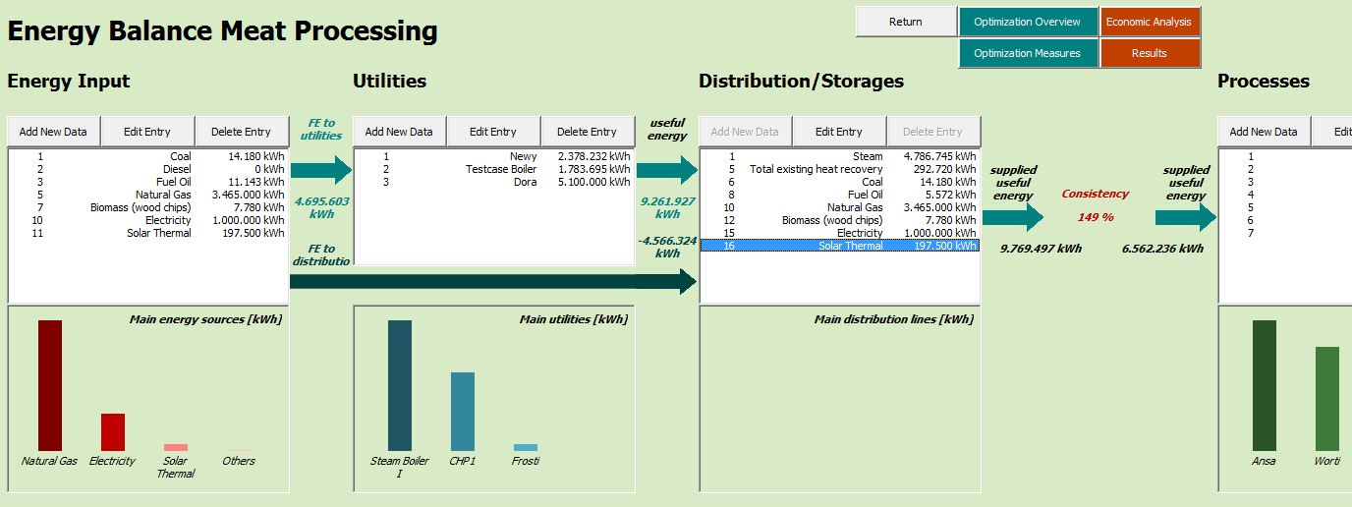
Branch Concept (3)

Slide 9
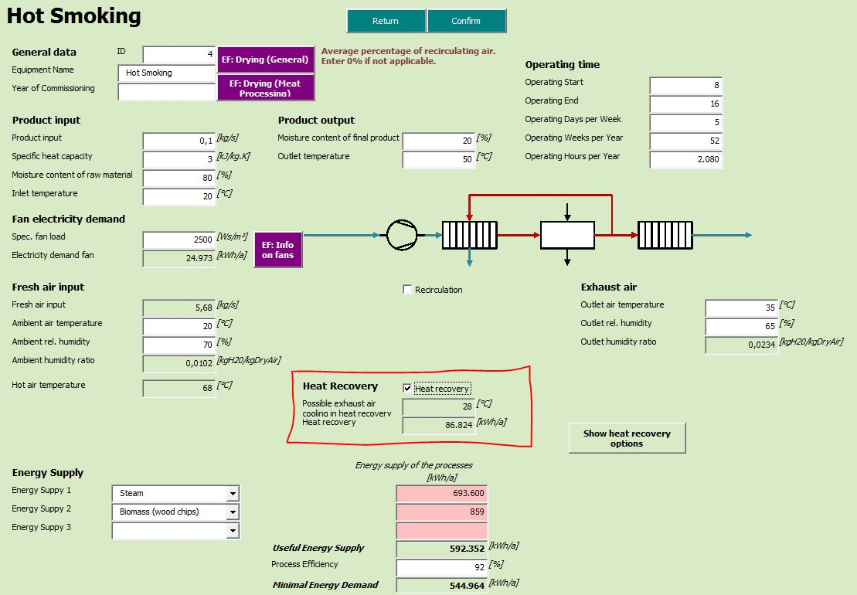
Branch Concept (4)

Slide 10
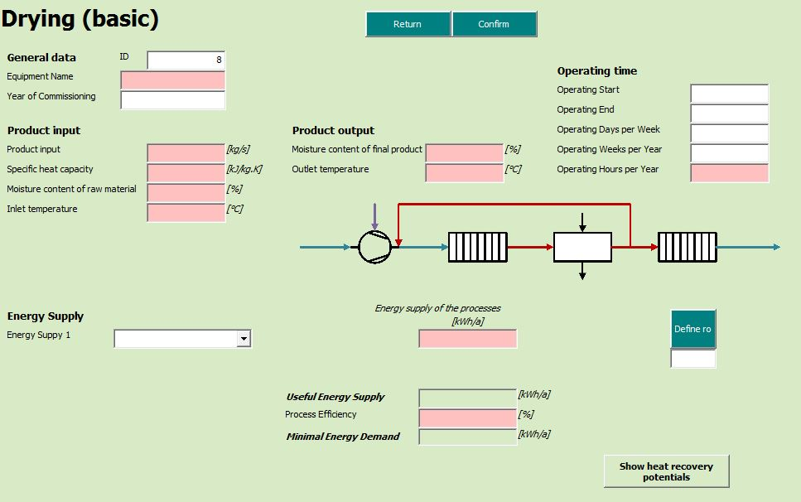
Branch Concept (5)

Slide 11
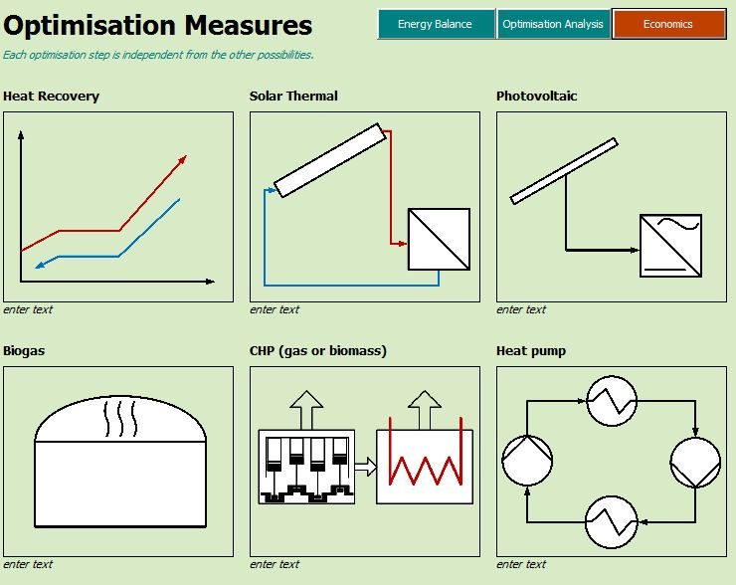
Branch Concept (6)

Slide 12
Introduction to WikiWeb
Compendium of case studies, best practice examples, best available technologies and funding guidelines that can easily be accessed by users and members: http://wiki.zero-emissions.at/index.php?title=Greenfoods_Wiki
Users can contribute to WikiWeb to enable interactive information resource (like Wikipedia): http://wiki.zero-emissions.at/index.php?title=Login_manual
For F&D sub-sectors, http://wiki.zero-emissions.at/index.php?title=Subsection_DA_food
Example for cost of technology (heat exchanger): http://wiki.zero-emissions.at/index.php?title=Cost_Analysis_of_Heat_Exchangers

Slide 13
Energy Training Module
For energy managers, energy auditors, energy experts, etc; to impart knowledge on smart and green technologies;
To introduce participants on the use of the branch concept, funding possibilities, energy audits, unit operations, processes, optimisation strategies and WikiWeb;
3-full-day event (free to register and attend, for a capacity of ~30 people, 12 of which will be trainers) between 30th of March 2015 and 3rd of April 2015 in Newcastle with CPD;
Current energy training courses are more focused on Building Energy Management more to conform with ISO 50001 (International Organization for Standardization) and EN 16001 (European Committee for Standardization) instead of Process Energy Management.

Slide 14
Virtual Energy Competence Centre
To offer the possibility of renting equipment, exchange of know-how, trainings, etc, and will be connected to European network (~240 members).
To tackle the current problem of lack of financing and boost investments in energy-efficiency and renewable energy technologies in the F&D sector.
To act here as platform for the GREENFOODS training course;
To support the continuation of the trainings and use of the branch concept;

Slide 15
Miscellaneous lessons learnt (1)
Chillers/refrigeration units, decentralised making heat recovery from condensers difficult; Only implemented in state-of-the-art building with centralised cold distribution where heat recovered is for office space heating;
More revenue usually means expansion of product line instead of investment in energy efficiency and/or renewable energy; there needs to be a study to compare the opportunity cost between expanding production lines & energy investment.
Fear of taste being compromised if new equipment/technology is used, changing process conditions; e.g. there have been cases where tanks are not covered in wort boiling in brewery allowing excess steam to escape.
LED and PV have long payback period ~12 years, especially since Fit-in-Tariff for PV has been lowered in the last 2 years.

Slide 16
Miscellaneous lessons learnt (2)
In cases like beer for example, where the trend towards regional small breweries' craft beer is on the rise, companies also do not have the incentive for energy efficiency/renewable implementation since rising cost of fluctuating fossil fuel can be passed on to consumers who do not mind paying a bit extra for craft beer;
Limited space to implement anaerobic digester, and an additional gas boiler will be necessary if the boiler used on-site is non-gas boiler;
Remove unnecessary heat producing equipment in chilled rooms;
Requiring the understanding food safety/quality prior to energy efficiency implementation.
In meat industry, 40-60% total energy consumption is for refrigeration therefore centralised distribution of heat and cold is important.

Slide 17
What next?
Potential for Branch Concept and WikiWeb to analyse and optimise food value chain (FVC) pathways to reduce energy consumption and CO₂ emission in the whole value chain through Horizon 2020 or Innovate UK; This especially important for policy makers, NGOs, co-operatives, large companies (with significant reach across value chain), as it allows for a lower CO₂ footprint FVC, with better energy independence, and improved nutrition delivery.
AEE INTEC (GREENFOODS project leader) and Newcastle are using lessons learnt on solar thermal collectors, fish/meat drying/smoking, and refrigeration fish/meat preservation to come up of a single integrated solar driven technology.

Slide 18
Find us at
http://www.green-foods.eu/
https://twitter.com/GREENFOODS_AEE

